Slide 1
Boolean Algebra
Digital Logic Design

Slide 2
Variable
A variable is a symbol usually an italic uppercase letter or word) used to represent an action, a condition, or data. Any single variable can have only a 1 or a 0 value.
The complement is the inverse of a variable and is indicated by a bar over the variable (overbar). For example, the complement of the variable A is A’. If A = 1, then A’ = 0. If A = 0, then A’ = 1.

Slide 3
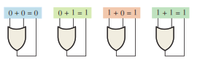
Boolean Addition
Boolean Addition : In Boolean algebra, a sum term is a sum of literals. In logic circuits, a sum term is produced by an OR operation with no AND operations involved. Some examples of sum terms are A + B, A + B, A + B + C, and A’ + B + C + D’.

Slide 4
Boolean Addition (cont.)
For example :Determine the values of A, B, C, and D that make the sum term A + B’ + C + D’ equal to 0
Solution : For the sum term to be 0, each of the literals in the term must be 0. Therefore, A = 0, B = 1 so that B’ = 0, C = 0, and D = 1 so that D’ = 0
A + B’ + C + D’ = 0 + 1 + 0 + 1 = 0 + 0 + 0 + 0 = 0

Slide 5

Boolean Multiplication
In Boolean algebra, a product term is the product of literals. In logic circuits, a product term is produced by an AND operation with no OR operations involved. Some examples of product terms are AB, AB, ABC, and ABCD.

Slide 6
Boolean Multiplication (cont.)
Determine the values of A, B, C, and D that make the product term AB’CD’ equal to 1.
Solution : For the product term to be 1, each of the literals in the term must be 1. Therefore, A = 1, B = 0 so that B’ = 1, C = 1, and D = 0 so that D’ = 1.
AB’CD’ = 1 . 0’ . 1 . 0’ = 1 . 1 .1 . 1= 1

Slide 7

Laws and Rules of Boolean Algebra
Commutative laws:
Commutative law of addition: A + B = B + A
This law states that the order in which the variables are ORed makes no difference. Remember, in Boolean algebra as applied to logic circuits, addition and the OR operation are the same.

Slide 8

Laws and Rules of Boolean Algebra (cont.)
Commutative law of multiplication for two variables is AB = BA
This law states that the order in which the variables are ANDed makes no difference. Remember, in Boolean algebra as applied to logic circuits, multiplication and the AND function are the same.

Slide 9

Laws and Rules of Boolean Algebra (cont.)
Associative Laws
The associative law of addition is written as follows for three variables:
A + (B + C) = (A + B) + C
This law states that when ORing more than two variables, the result is the same regardless of the grouping of the variables.

Slide 10

Laws and Rules of Boolean Algebra (cont.)
Associative law of multiplication: The associative law of multiplication is written as follows for three variables: (A.B).C = A.(B.C)
This law states that it makes no difference in what order the variables are grouped when ANDing more than two variables.

Slide 11
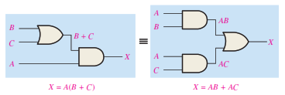
Laws and Rules of Boolean Algebra (cont.)
Distributive Law :
The distributive law is written for three variables as follows:
A(B + C) = AB + AC
This law states that ORing two or more variables and then ANDing the result with a single variable is equivalent to ANDing the single variable with each of the two or more variables and then ORing the products.

Slide 12
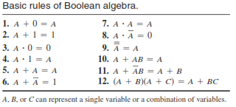
Laws and Rules of Boolean Algebra

Slide 13

Laws and Rules of Boolean Algebra (cont.)
Rule 1: A + 0 = A
A variable ORed with 0 is always equal to the variable. If the input variable A is 1, the output variable X is 1, which is equal to A. If A is 0, the output is 0, which is also equal to A.

Slide 14
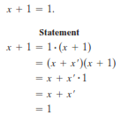

Laws and Rules of Boolean Algebra (cont.)
Rule 2: A + 1 = 1
A variable ORed with 1 is always equal to 1. A 1 on an input to an OR gate produces a 1 on the output, regardless of the value of the variable on the other input.

Slide 15

Laws and Rules of Boolean Algebra (cont.)
Rule 3: A . 0 = 0
A variable ANDed with 0 is always equal to 0. Any time one input to an AND gate is 0, the output is 0, regardless of the value of the variable on the other input.

Slide 16

Laws and Rules of Boolean Algebra (cont.)
Rule 4: A . 1 = A
A variable ANDed with 1 is always equal to the variable. If A is 0, the output of the AND gate is 0. If A is 1, the output of the AND gate is 1 because both inputs are now 1s.

Slide 17
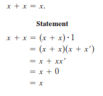


Laws and Rules of Boolean Algebra (cont.)
Rule 5: A + A = A
A variable ORed with itself is always equal to the variable. If A is 0, then 0 + 0 = 0; and if A is 1, then 1 + 1 = 1.
Rule 6: A + A’ = 1
A variable ORed with its complement is always equal to 1. If A is 0, then 0 + 0 = 0 + 1 = 1. If A is 1, then 1 + 1 = 1 + 0 = 1

Slide 18



Laws and Rules of Boolean Algebra (cont.)
Rule 7: A.A = A
A variable ANDed with itself is always equal to the variable. If A = 0, then 0 .0 = 0; and if A = 1, then 1 .1 = 1.
Rule 8: A . A’ = 0
A variable ANDed with its complement is always equal to 0. Either A or A will always be 0; and when a 0 is applied to the input of an AND gate, the output will be 0 also.

Slide 19

Laws and Rules of Boolean Algebra (cont.)
Rule 9: (A’)’ =A
The double complement of a variable is always equal to the variable. If you start with the variable A and complement (invert) it once, you get A’. If you then take A’ and complement (invert) it, you get A, which is the original variable.

Slide 20

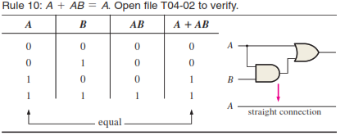
Laws and Rules of Boolean Algebra (cont.)
Rule 10: A + AB = A
This rule can be proved by applying the distributive law, rule 2, and rule 4 as follows:

Slide 21
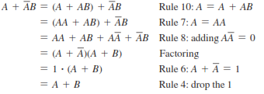
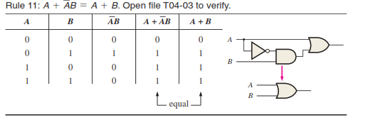
Laws and Rules of Boolean Algebra (cont.)
Rule 11: A + A’B = A + B This rule can be proved as follows:

Slide 22
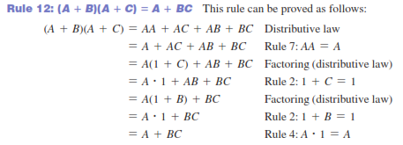
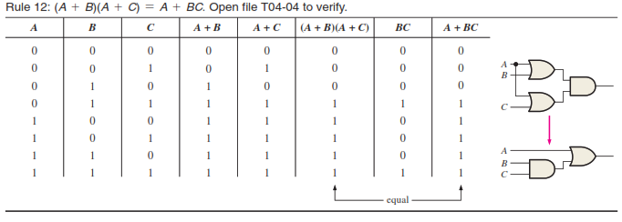
Laws and Rules of Boolean Algebra (cont.)
Rule 12: (A + B)(A + C) = A + BC: This rule can be proved as follows

Slide 23
Laws and Rules of Boolean Algebra (cont.)
DeMorgan’s first theorem is stated as follows:
The complement of a product of variables is equal to the sum of the complements of the variables
DeMorgan’s second theorem is stated as follows:
The complement of a sum of variables is equal to the product of the complements of the variables.

Slide 24


Laws and Rules of Boolean Algebra (cont.)

Slide 25
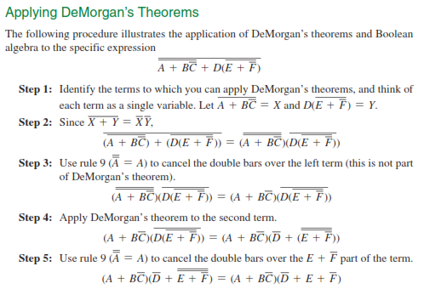
Laws and Rules of Boolean Algebra (cont.)

Slide 26
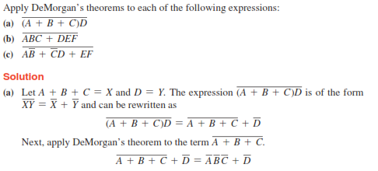
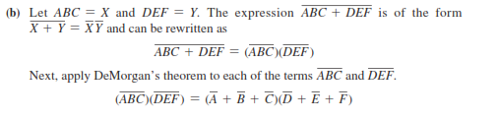
Laws and Rules of Boolean Algebra (cont.)

Slide 27
Laws and Rules of Boolean Algebra (cont.)
Class Task

